Slide 1
Introduction to Distributed Computing and Cloud Fundamentals:
Course: Virtualization and Cloud Computing

Slide 2
LECTURE OBJECTIVES
Understand the evolution of computing systems
Learn distributed computing principles
Introduce cloud computing
Identify key characteristics
Discuss benefits, challenges & business drivers

Slide 3
WHY STUDY CLOUD COMPUTING?
Backbone of modern IT systems
Enables scalability and global access
Foundation of AI, Big Data, IoT
Widely used in industry (AWS, Azure, GCP)

Slide 4
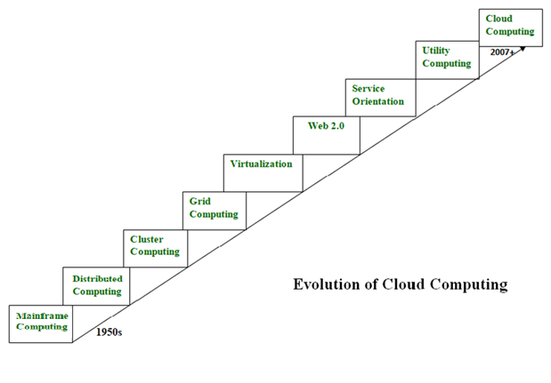
EVOLUTION OF COMPUTING SYSTEMS
Image Reference: GeeksforGeeks

Slide 5
Mainframe Computing(1950-1970)
Mainframes originated in 1951
Highly powerful and reliable computing systems
Designed to handle large-scale data and I/O operations
Widely used for bulk processing (e.g., online transactions)
Feature high fault tolerance and near-zero downtime
Offer increased processing capabilities after distributed system
Very expensive, limiting widespread use
Cluster computing emerged to be as cost-effective

Slide 6
Distributed Systems(1970-1980)
consists of multiple independent systems
Appears as a single entity to users
Enables resource sharing and efficient utilization
Key characteristics: Scalability, Concurrency, Continuous availability, Heterogeneity, Independent failure handling

Slide 7
Cluster Computing (1980s)
Introduced as an alternative to mainframe computing
Consists of multiple machines connected via high-bandwidth networks
More cost-effective than mainframes
Capable of high computational performance
Scalable – new nodes can be easily added
Limitation: geographical restrictions still existed

Slide 8
Grid Computing (1990s)
Systems located at different geographical locations
Connected through the internet
Nodes belong to multiple organizations
Consists of heterogeneous systems
Solved location constraints but introduced:
Low bandwidth availability
Network latency and reliability issues
Considered the predecessor of cloud computing

Slide 9
Utility Computing
Computing model based on pay-per-use
Services include:
Compute
Storage
Infrastructure
Resources are provisioned on demand

Slide 10
Virtualization
IBM released VM/370 in 1972, its first official virtual machine product, making virtualization a standard offering for its System/370 mainframes.
Creates a virtual layer over hardware
Allows multiple virtual instances on a single machine
Core technology behind cloud computing
Used by platforms like Amazon EC2 and VMware vCloud
Hardware virtualization is the most common type

Slide 11
Web 2.0
Interface enabling interaction between cloud services and users
Enables interactive and dynamic web pages
Improves flexibility and user collaboration
Foundation of social media platforms
Examples: Google Maps, Facebook, Twitter
Gained popularity around 2004

Slide 12
Service Orientation
Acts as a reference model for cloud computing
Supports low-cost, flexible, and scalable applications
Key concepts introduced:
Quality of Service (QoS)
Service Level Agreements (SLA)
Software as a Service (SaaS)

Slide 13
Distributed computing principles
Resource Sharing
Efficient sharing of data, hardware, and services among systems
Transparency
The system appears as a single entity, hiding complexity from users.
Scalability
Ability to grow in users, resources, and workload without loss of performance.
Fault Tolerance & Reliability
System continues to operate despite failures of individual components.
Concurrency
Multiple processes and users can work simultaneously without conflict.

Slide 14
Introduction to cloud computing
Data and applications are stored on remote servers over the Internet
Eliminates dependence on local hard drives or local servers
Also known as Internet-based computing
Resources are delivered as services via the Internet
Supports storage of files, documents, images, and other data

Slide 15
Introduction to cloud computing
Cloud computing is Internet-based computing, whereby shared resources, software, and information are provided to computers and other devices on demand, like the electricity grid.
Cloud computing is a paradigm where details are abstracted from the users, who no longer have need for expertise in, or control over, the technology infrastructure "in the cloud" that supports them.

Slide 16
What is cloud computing?
Cloud computing is Internet based computing where virtual shared servers provide software, infrastructure, platform, devices and other resources and hosting to customers on a pay-as-you-use basis.
All information that a digitized system has to offer is provided as a service in the cloud computing model. Users can access these services available on the "Internet cloud" without having any previous know-how on managing the resources involved

Slide 17
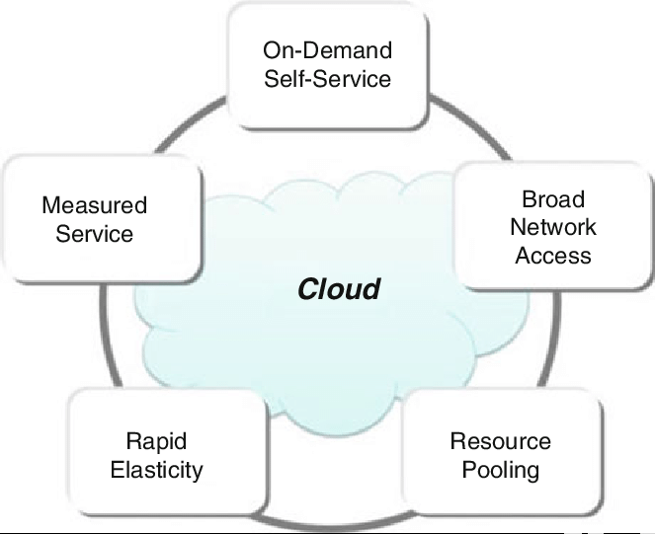
Characteristics of cloud computing
Image Credits: GeeksForGeeks

Slide 18
Characteristics of cloud computing
On-Demand Self-Service:
Users can automatically get computing resources (like server time, storage, networking) as needed, without human intervention from the provider.
Broad Network Access:
Services are available over the network (internet) and accessible via standard mechanisms on various devices (laptops, phones, tablets).
Resource Pooling:
The provider's resources (servers, storage, etc.) are pooled to serve multiple customers (multi-tenant model), with resources dynamically assigned and reassigned as demand changes.

Slide 19
Characteristics of cloud computing
Rapid Elasticity:
Capabilities can be scaled out (up) and in (down) quickly and elastically, appearing unlimited to the consumer, matching demand automatically.
Measured Service:
Resource usage (storage, processing, bandwidth) is automatically monitored, controlled, and optimized, allowing for pay-per-use billing.

Slide 20
Benefits of Cloud Computing
Cost Efficiency
Pay-as-you-use model reduces capital and maintenance costs.
Scalability & Flexibility
Resources can be scaled up or down on demand.
High Availability & Reliability
Ensures minimal downtime with backup and disaster recovery.
Accessibility & Mobility
Data and applications can be accessed from anywhere via the Internet.
Automatic Updates & Maintenance
Cloud providers handle infrastructure management.
Efficient Resource Utilization
Optimized use of computing and storage resources.

Slide 21
Challenges of Cloud Computing
Security & Privacy Risks
Data stored off-premises may face security threats.
Internet Dependency
Requires reliable and high-speed network connectivity.
Downtime & Service Outages
Provider outages can impact availability.
Limited Control & Vendor Lock-in
Dependence on a single provider may restrict flexibility.
Compliance & Legal Issues
Data location and regulatory requirements can be challenging.
Performance & Latency Issues
Network delays can affect application performance.

Slide 22
Business drivers for cloud adoption
Cost Optimization
Shifts CapEx to OpEx with pay-as-you-go pricing
Reduces infrastructure and maintenance costs
Agility & Speed
Rapid provisioning and scaling of resources
Faster deployments and quicker adaptation to market changes
Scalability & Elasticity
Easily scale resources up or down based on demand
Avoids over-provisioning during peak or seasonal loads
Innovation Enablement
Access to advanced technologies like AI, ML, and Big Data
Focus on application development instead of infrastructure

Slide 23
Business drivers for cloud adoption
Security & Compliance
Advanced security, backup, and disaster recovery capabilities
Often stronger than traditional on-premise solutions
Digital Transformation
Supports remote work, collaboration, and data-driven decision-making
Efficiency & Productivity
Automation and simplified IT management
Frees IT teams to focus on strategic business goals
Competitive Advantage
Faster response to customer needs
Quicker introduction of new products and services

